Slide 1


Progressive Web Apps
2020-02-01

Slide 2


Our attention augmented model: first results
Oueslati Mohamed Karim
Head of Web and Mobile @ InstaDeep
Email : mk.oueslati@instadeep.com
LinkedIn : linkedin.com/in/mohamed-karim-oueslati/
Progressive
Web Apps

Slide 3

Any idea about PWAs?

Slide 4
Progressive Web Apps
are a new level of caring about
the quality of your user experience
Notes:
If you forget the entire rest of my presentation today, I hope you remember this slide.
Progressive Web Apps are a whole new level of caring about the quality of your end-to-end user experience.
At the end of the day Progressive web apps describe a set of features of technologies you can add to your existing
web applications to turn them into native app-like, using features like
=> push notifications
=> Background sync
=> offline accessiblity
=> access to sensors like camera
=> get user location

Slide 5



User experiences need to be...
Reliable
Notes:
In order to build that new level of user experience, we need to improve applications built for the web - web apps need to be reliable, and have reliable performance.
=> Be raliable: Load fast and provide offline functionality

Slide 6

Notes:
We’ve become used to ALWAYS being online - so when we see this cute little offline dinosaur - the downasaur- it’s a disaster!

Slide 7

This is me after
seeing
the downasaur
in the Browser :’(
Notes:
To be honest with you this is my reaction when i see the downasaur in the browser,
I don’t know if it’s the same for you!!

Slide 8
Reliability means never showing
the offline dinosaur
Notes:
In fact Mobile apps never show us the downasaur. So the web developer community said we need web apps to serve something even if we are offline.

Slide 9
Reliable
Fast
Notes:
Our PWA need to be fast that means Respond quickly to user actions

Slide 10


40%
of users abandon sites that take longer than 3 seconds to load
Notes:
You may have heard the saying “time is money”. This is certainly true for web users - studies have shown that after 3 seconds, 40% of users will abandon the experience! This means loading a web app has to be invisible and feel instantaneous.

Slide 11
Reliable
Fast
Engaging
Notes:
We want to make sure that our app is engaging.
We want to get our users back into the app
We want to offer features like push notifications to inform them even if the application is closed
We want to facilitate the access to the app by making it installable from the browser, so user can access to the app by clicking on its icon.

Slide 12
PWAs vs Native Mobile Apps
Notes:
Now we will do a little comparaison between PWAs ans Native Mobile Apps

Slide 13
13%
vs.
87%
Mobile web
Apps
Notes:
On mobile, users spend most of their time in native apps, rather than the web. Only 13% of users’ mobile time is on the mobile web, vs 87% spent in apps, as of last year. Apps are more predictable, and they have some great re-engagement features - like home screen icons, and push notifications that brings users back even when the app is closed.
This slide might make it seem like I could cut my presentation short, say “build native apps”, and go home early. But there’s a flip side to this...

Slide 14
80%
OF TIME SPENT IS IN
USERS’ TOP 3 APPS
Notes:
App usage is highly concentrated. Users tend to only use a few apps - leading to a winner-take all situation. Based on user studies - people see native apps as a big commitment in space, time, and cost. Native apps may be engaging, but only a few are worth installing.
So NAtive Mobile Apps Market is huge, but users spent 80% of their time using only 3 apps, for me i only use Facebook, Messenger and Pro evolution Soccer 2019.

Slide 15
65% of users download 0 apps
80% of apps
are uninstalled
within 1 week
Notes:
Most of apps on our phones are installed when we buy a new phone or when we reinstall the OS.
After That 65% of users download 0 apps, and 80% of new installed apps are uninstalled after a week or less.

Slide 16
Capability
Reach
Notes:
One way to think of the differences between native and web apps is on the capability axis - native apps have the ability to start up reliably when you tap their icon. They boot up quickly, they tend to work offline (who here has opened a web browser to use a web app when they KNOW their device is offline?), they can send push notifications, and sync in the background, they have access to sensors like microphone and camera...by contrast, the Web is safer, and more respectful of privacy
The Question here is :
what if we could add the capabilities we need, and the web could meet those UX expectations? We could have the best of both worlds.

Slide 17
Capability
Reach
Notes:
This is what Progressive Web Apps represent - a user experience good enough, integrated enough, to earn a place on the home screen and in the notification tray, without having to give up reach to get it.

Slide 18
How do I get started?
Notes:
How do i get started
THat’s a good question

Slide 19
Stay Secure
Notes:
First of all, you need security.
You must have an active HTTPS Certificate.

Slide 20
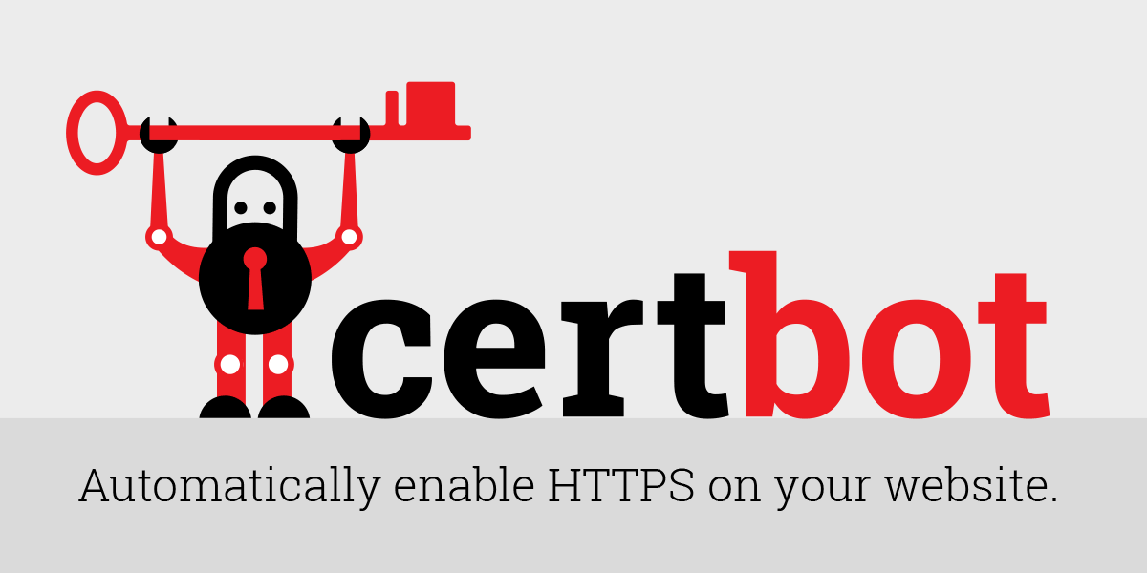
Visit : https://certbot.eff.org for more details
Notes:
For that i suggest to use CertBot to enable HTTPS on our Website because it’s free, very easy to use, we can renew the certificate easily

Slide 21
Core Building Blocks
Service Workers
Background Snyc
Sync User Data in the Background
Caching/
Offline Support
Enable other PWA Features
Web Push
Mobile-like Push Notifications
Geolocation API
Access User Location
Application Manifest
Allows Addition to Home screen
Media API
Access Device Camera And Microphone
Notes:
The core feature of PWA are Service workers. Service Workers are supported in modern browsers like chrome, firefox, safari and Edge.
Service workers are basically JS running in a background process even if your web application is closed.
[click] Service workers are a core building block because they allow us to get offline access, to cache some files and serve them if we don’t have internet connection. AND also give us access to other progressive web app related Features.
[click] Like background Synchronization, sending a request once internet connection is re-established
[click] Push notifications would be another example, we use SW for that because they are running in the background.
[click] application manifest makes your application installable on home screen, that works for phones tablets and computer.
[click] there are other things like geolocation API or Media API, so that we can access various native device features

Slide 22
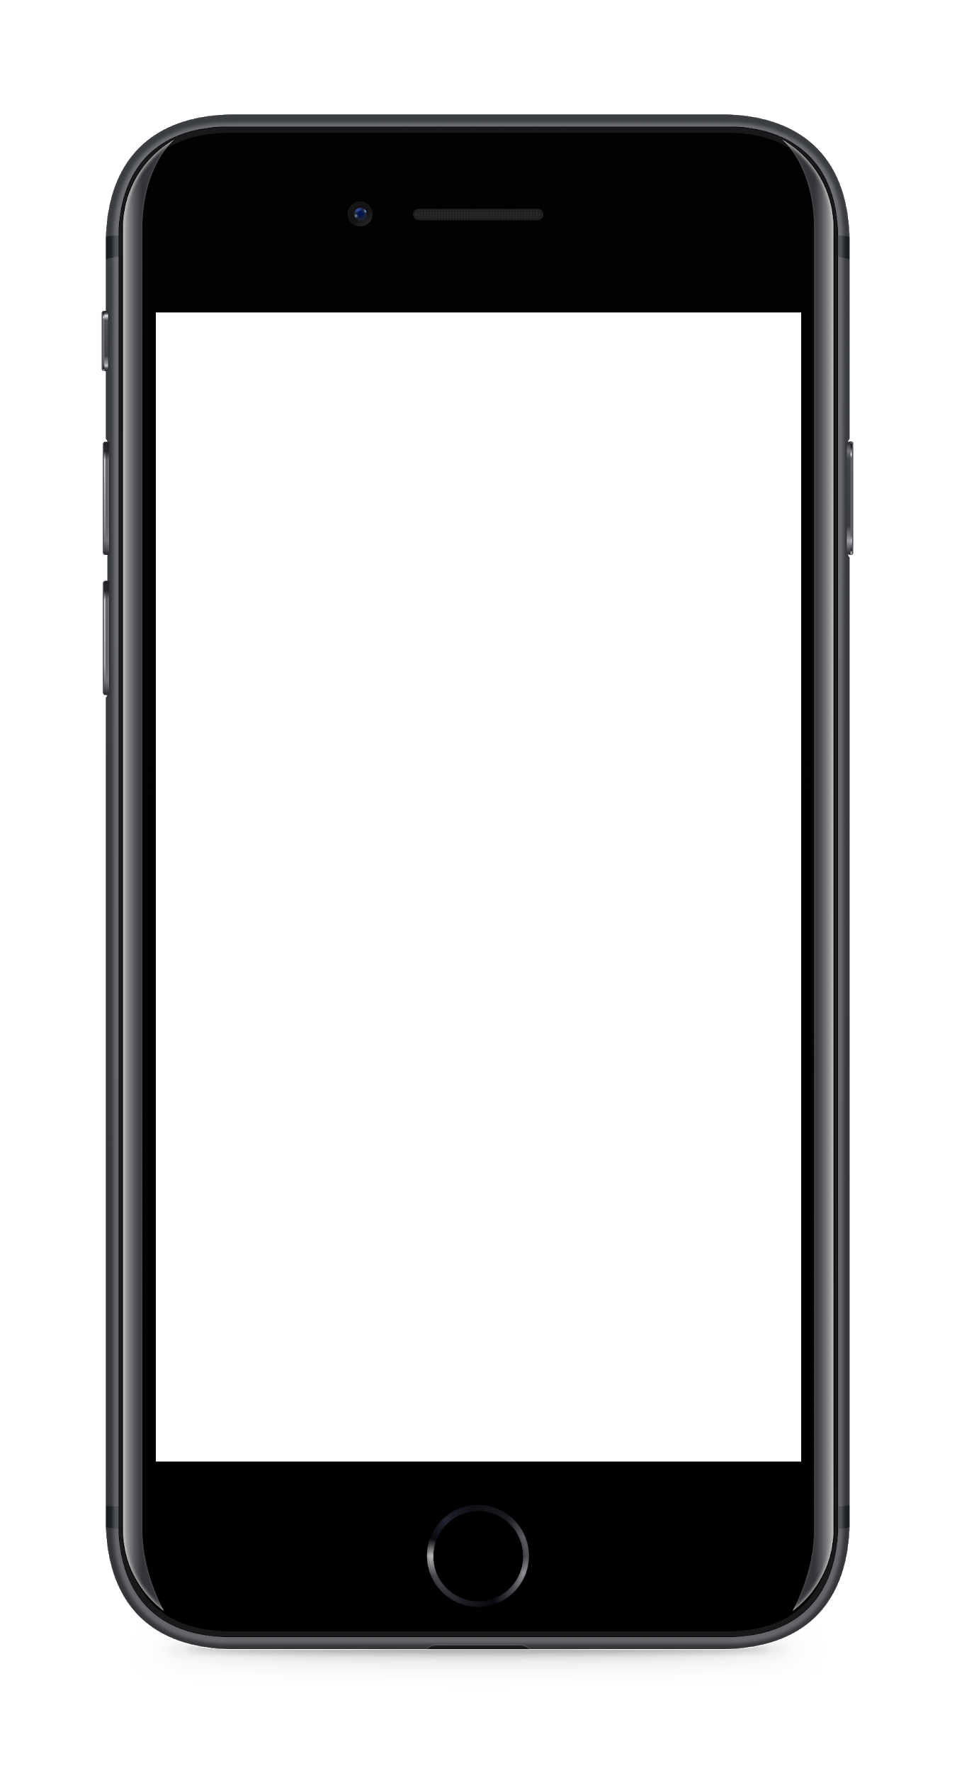
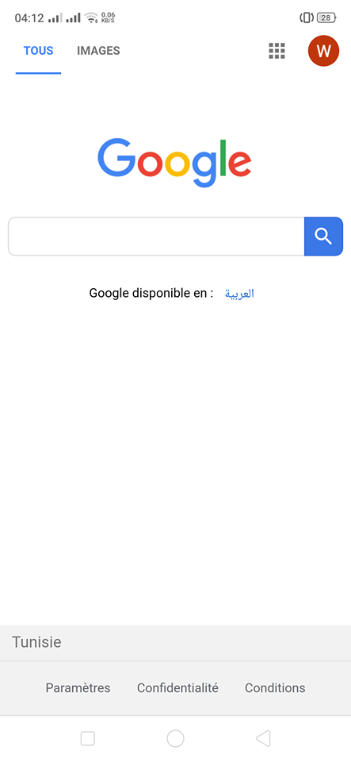
Web server
Notes:
In a traditional web app when we are offline the downasaure appears [Click]

Slide 23


Service worker
Web server
Cache
Notes:
Like we said earlier SW is Javascript Runing in Background even if our web app is closed. It works like a proxy between the browser and the web app. So SW will receive client request and send them to the web server. Also it will receive Server response and send them to client browser. In case of network issues the service worker show latest version from the cache.

Slide 24

The Service Worker Lifecycle
Installing
Active
Notes:
in the first load or for the first time we open the web app,the browser will install th SW and activate it, So our SW will run in background, handle all our requests even in offline mode, manage push notification, synchronize in background mode etc.

Slide 25
Best PWA Examples

Slide 26
Financial Times : https://app.ft.com
2048 game : https://2048-opera-pwa.surge.sh/

Slide 27
Thanks!!

